Slide 1
CSE 185 Introduction to Computer Vision
Cameras

Slide 2
Cameras
Camera models
Pinhole perspective projection
Weak perspective
Affine Projection
Camera with lenses
Sensing
Human eye
Reading: S Chapter 2

Slide 3
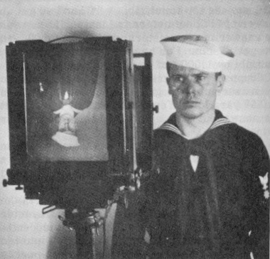
They are formed by the projection of 3D objects
Figure from US Navy Manual of Basic Optics and Optical Instruments, prepared by Bureau of
Naval Personnel. Reprinted by Dover Publications, Inc., 1969.
Images are two-dimensional patterns of brightness values

Slide 4
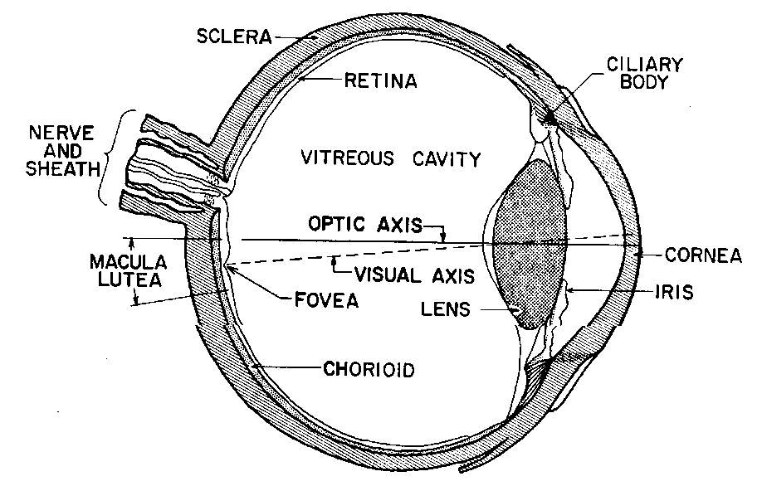
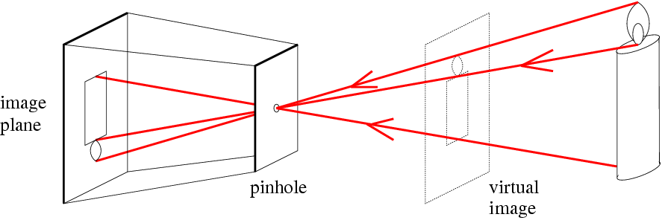
Figure from US Navy
Manual of Basic Optics
and Optical Instruments,
prepared by Bureau of
Naval Personnel. Reprinted
by Dover Publications,
Inc., 1969
Photographic camera:
Niepce, 1816
Animal eye: a long time ago
Pinhole perspective projection: Brunelleschi, XVth Century.
Camera obscura: XVIth Century

Slide 5
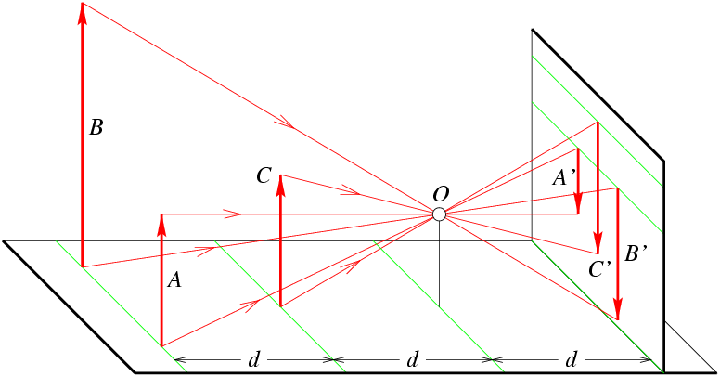
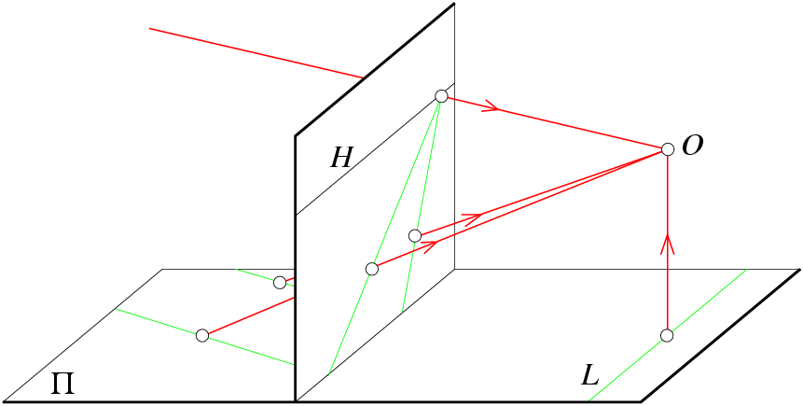
A is half the size of B
C is half the size of B
B’ and C’ have the same size
Parallel lines: converge on
a line formed by the intersection of a plane parallel to π and image plane
L in π that is parallel to image plane has no image at all

Slide 6


Vanishing point
See https://www.youtube.com/watch?v=4H-DYdKYkqk for more explanations

Slide 7
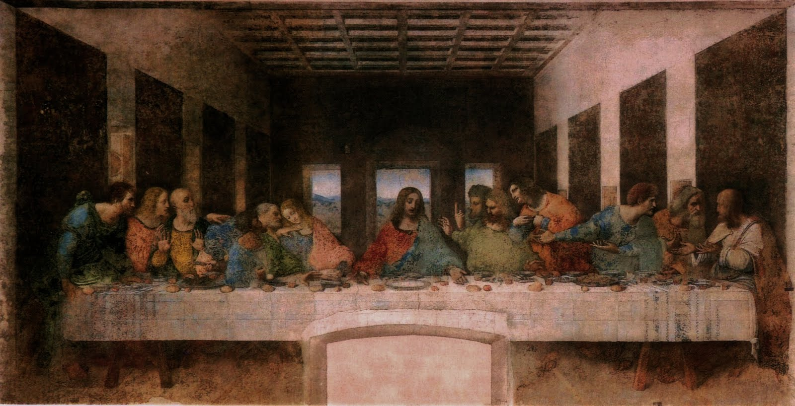
Vanishing point
Last Supper, Leonardo da Vinci

Slide 8
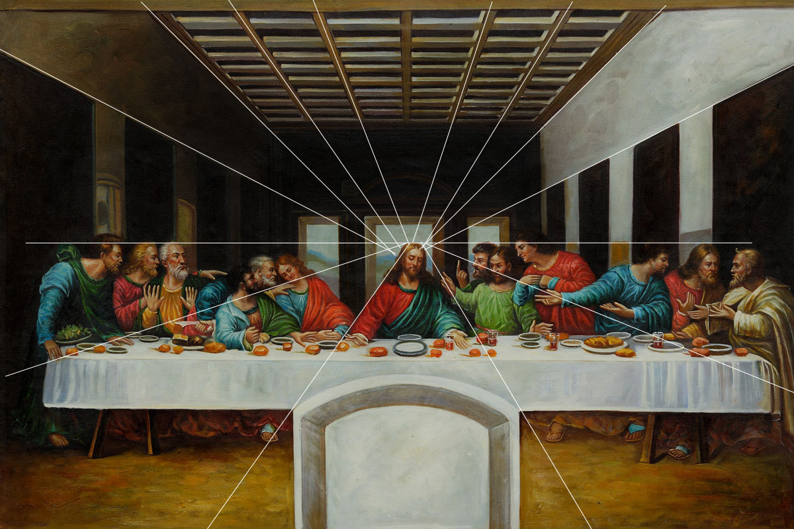
Vanishing line
The lines all converge in his right eye, drawing the viewers gaze to this place

Slide 9

Urban scene

Slide 10
Vanishing points and lines
Vanishing Point
Vanishing Point
o
o
Vanishing Line
The projections of parallel 3D lines intersect at a vanishing point
The projection of parallel 3D planes intersect at a vanishing line
If a set of parallel 3D lines are also parallel to a particular plane, their vanishing point will lie on the vanishing line of the plane
Not all lines that intersect are parallel
Vanishing point <-> 3D direction of a line
Vanishing line <-> 3D orientation of a surface
Notes:
Go to board, sketch out various properties of vanishing points/lines
Parallel lines intersect at a point
The intersection of red lines and blue lines form a parallelogram
Sets of parallel lines on the same plane form a vanishing line
Sets of parallel planes form a vanishing line
Not all lines that intersect are parallel

Slide 11
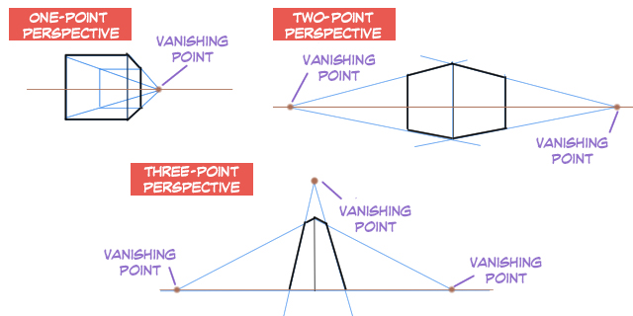
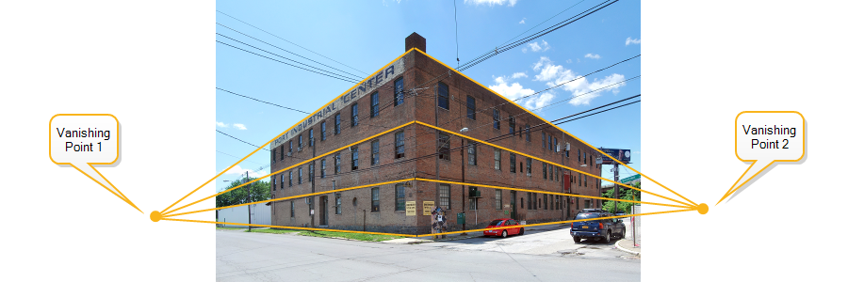
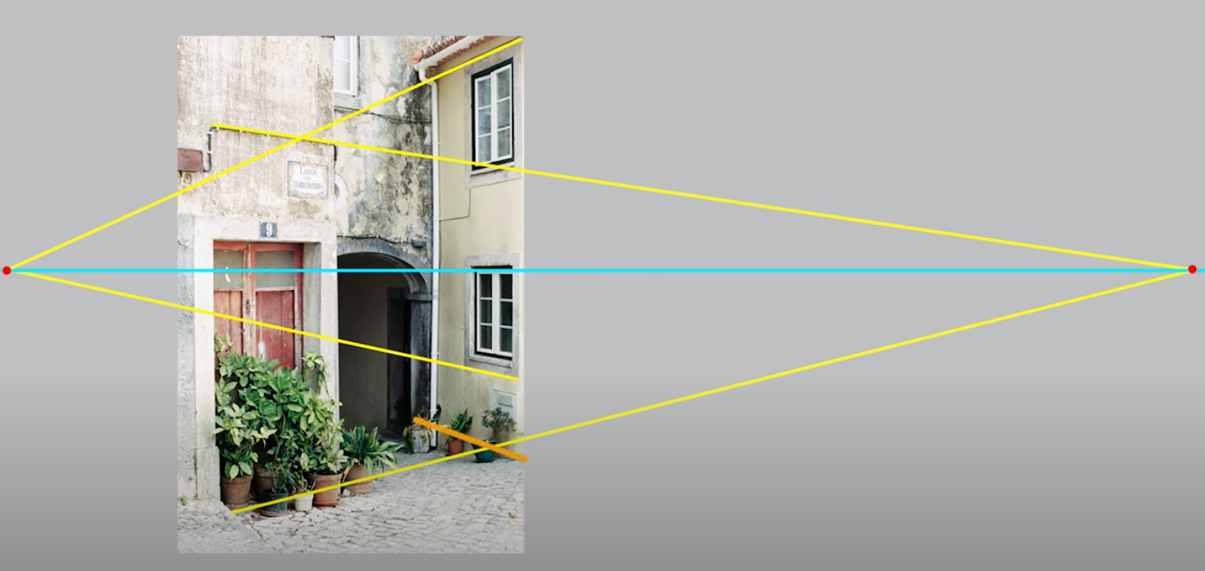
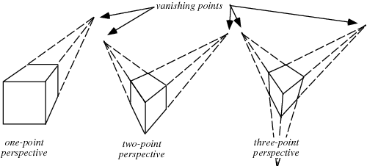
Perspectives
See https://www.youtube.com/watch?v=2HfIU5lp-0I&t=1s for more explanations

Slide 12
Vanishing pint: applications
Camera calibration:
Use the properties of vanishing points to find intrinsic and extrinsic camera parameters
3D reconstruction:
Man-made structures have two main characteristics: several lines are in parallel and a number of edges are orthogonal
Using sets of parallel lines, the orientation of the plane can be estimated using vanishing points
Robot navigation

Slide 13
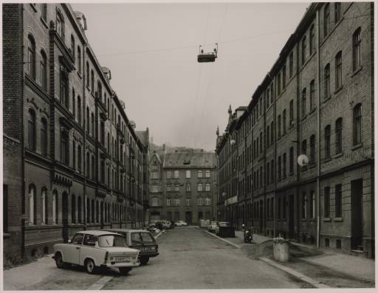
Vanishing points and lines
Photo from online Tate collection
Notes:
Where are the vanishing points? Do buildings on left and buildings on right have the same vanishing line? Which way is the camera tilted?

Slide 14
Note on estimating vanishing points
Use multiple lines for better accuracy
… but lines will not intersect at exactly the same point in practice
One solution: take mean of intersecting pairs
… bad idea!
Instead, minimize angular differences
Notes:
Go to board, sketch out various properties of vanishing points/lines

Slide 15

Vanishing points and lines
Vertical vanishing
point
(at infinity)
Vanishing
line
Vanishing
point
Vanishing
point
Slide from Efros, Photo from Criminisi

Slide 16
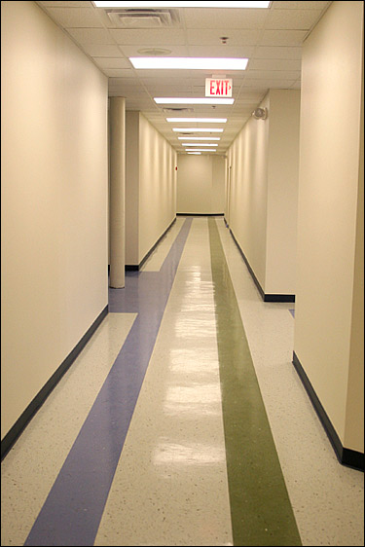
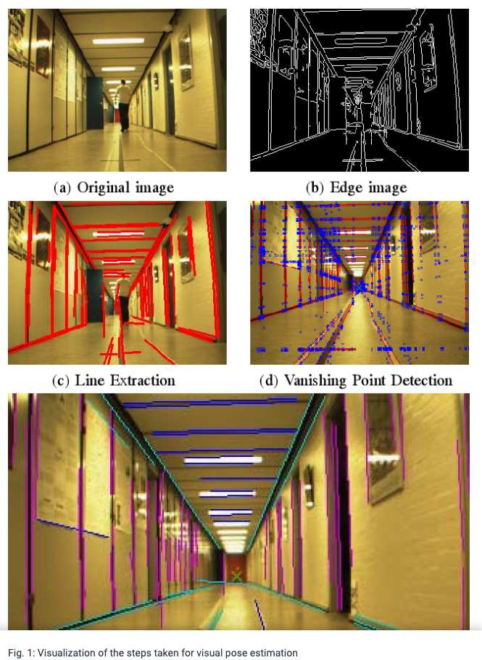
Robot navigation

Slide 17
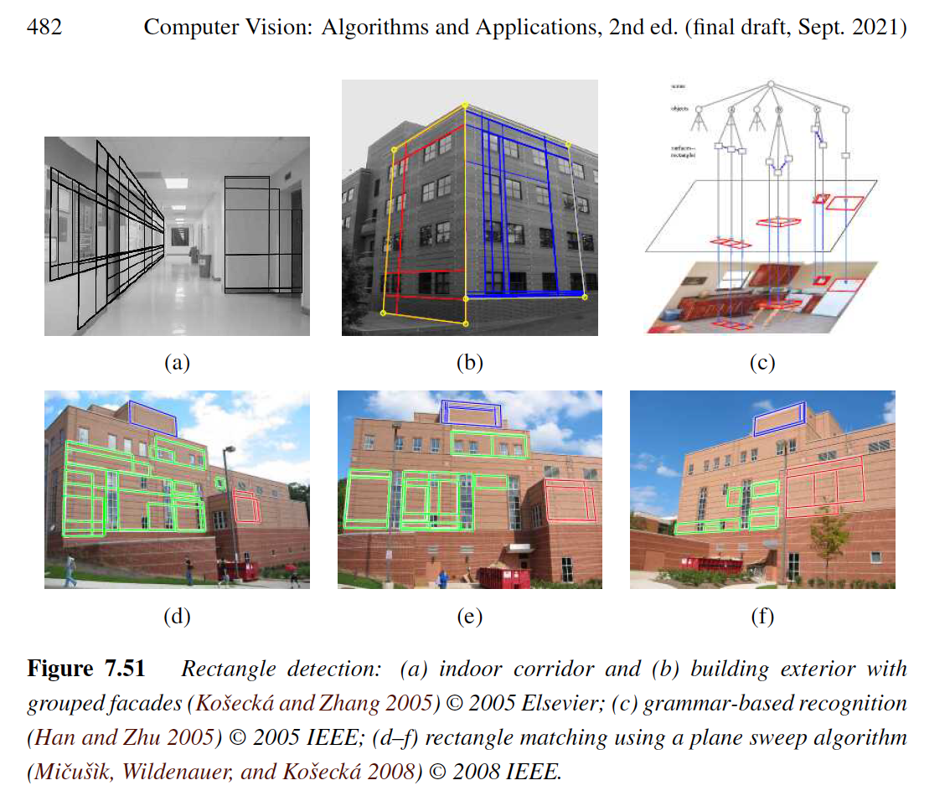
Orthogonal vanishing points
Once sets of mutually orthogonal vanishing points are detected, it is possible to search for 3D rectangular structures in the image

Slide 18
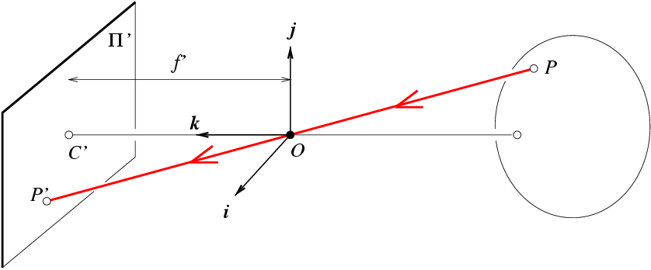
Pinhole perspective equation
P:(x, y, z)
P’: (x’, y’, z’)
i axis -> x
j axis -> y
z axis -> z
C’ :image center
OC’ : optical axis
π’ : image plane is at a positive distance f’ from the pinhole
OP’= λ OP and z’=f’
NOTE: z is always negative

Slide 19
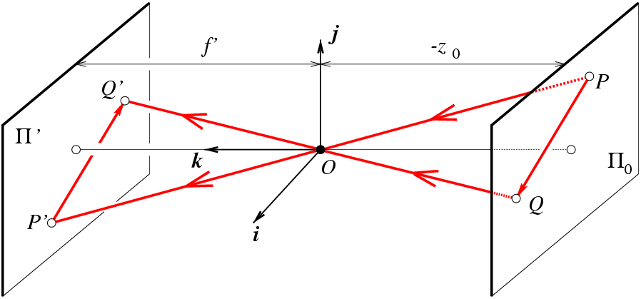
Weak perspective projection
frontal-parallel plane
π₀ defined by z=z₀
is the magnification
When the scene relief (depth) is small compared its distance from the
camera, m can be taken constant → weak perspective projection

Slide 20
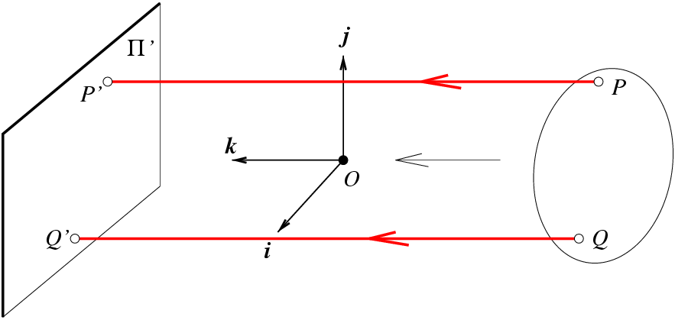
Orthographic projection
When the camera is at a (roughly constant) distance from the scene, take m=-1
→ orthographic projection

Slide 21
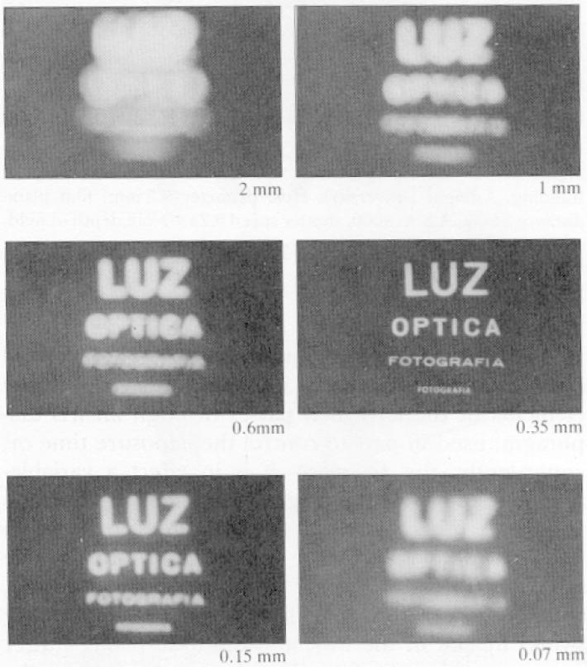
Issues with pinhole camera
Pinhole too big:
many directions are averaged, blurring the image
Pinhole too small: diffraction effects blur the image
Generally, pinhole
cameras are dark, because
a very small set of rays
from a particular point
hits the screen

Slide 22
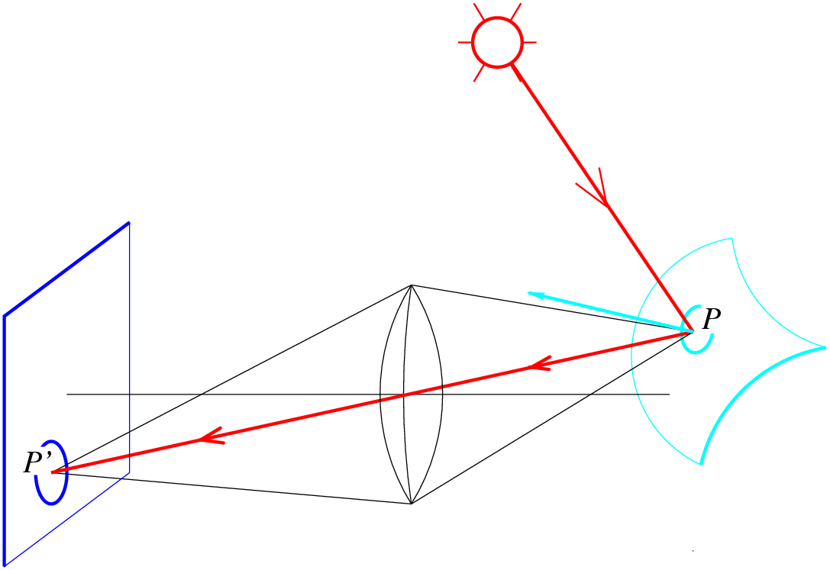
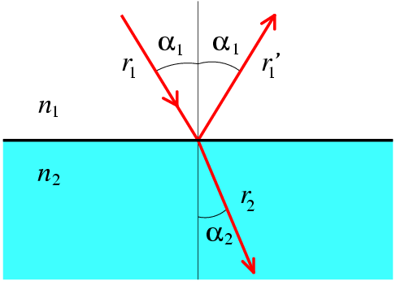
Lenses
Snell’s law (aka Descartes’ law)
n₁ sin α₁ = n₂ sin α₂
n₁: incident index
n₂: refracted index
reflection
refraction

Slide 23
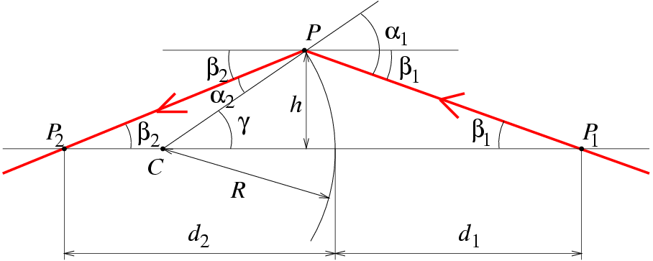
Paraxial (or first-order) optics
Snell’s law:
n₁ sin α₁ = n₂ sin α₂
Small angles:
n₁α₁ = n₂α₂

Slide 24
Paraxial (or first-order) optics
Small angles:
n₁α₁ = n₂α₂

Slide 25
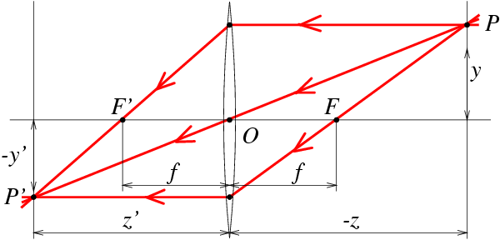
Thin lens
All other rays passing through P are focused on P’
f: focal length F, F’: focal points

Slide 26
Depth of field and field of view
Depth of field (field of focus): objects within certain range of distances are in acceptable focus
Depends on focal length and aperture
Field of view: portion of scene space that are actually projected onto camera sensors
Not only defined by focal length
But also effective sensor area

Slide 27
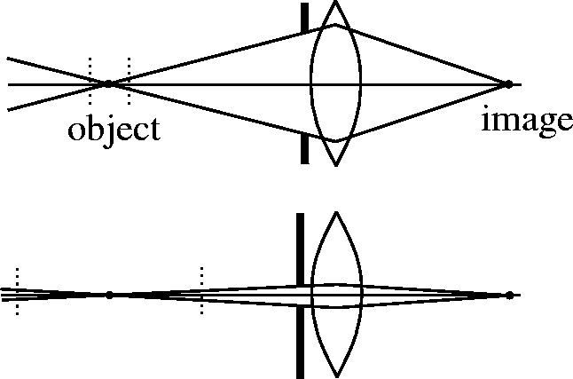


Depth of field
f / 5.6 (large aperture)
f-number: N=f/D
f: focal length
D: aperture diameter
f / 32 (small aperture)
Changing the aperture size affects depth of field
Increasing f-number (reducing aperture diameter) increases DOF
A smaller aperture increases the range in which the object is approximately in focus

Slide 28
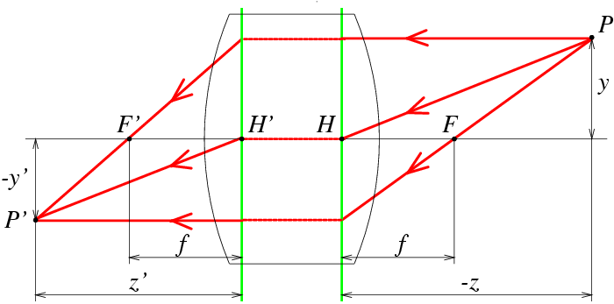
Thick lenses
Simple lenses suffer from several aberrations
First order approximation is not sufficient
Use 3rd order Taylor approximation

Slide 29

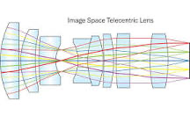
Orthographic (“telecentric”) lenses
Navitar telecentric zoom lens
Telecentric lens

Slide 30
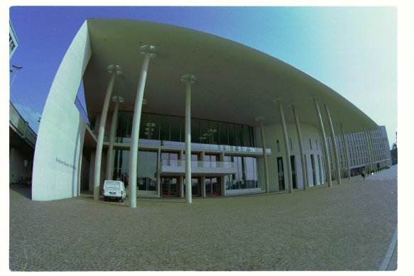
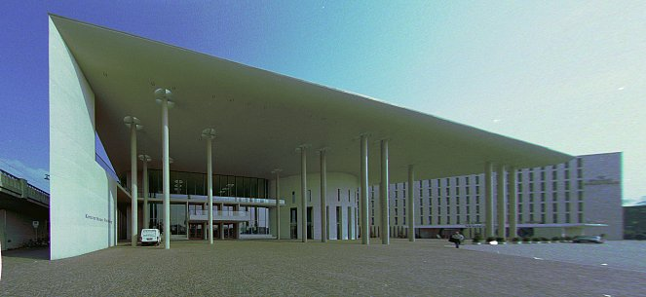
Correcting radial distortion

Slide 31
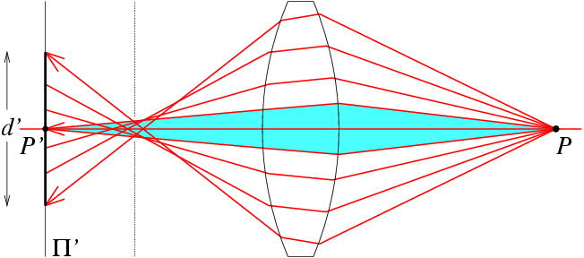
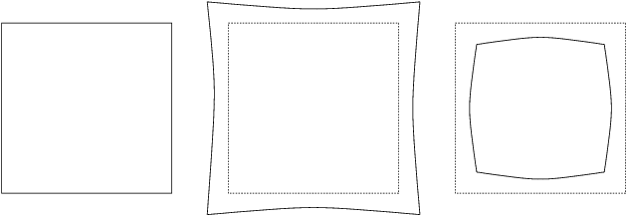
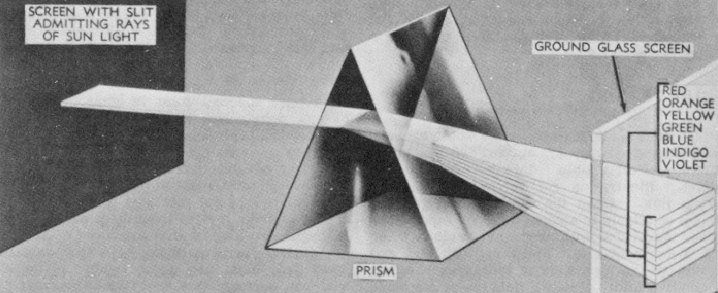
Spherical
Aberration
rays do not intersect at one point
circle of least confusion
Distortion
(optics)
pincushion
barrel
Chromatic
Aberration
refracted rays of different
wavelengths intersect the optical axis at different points

Slide 32
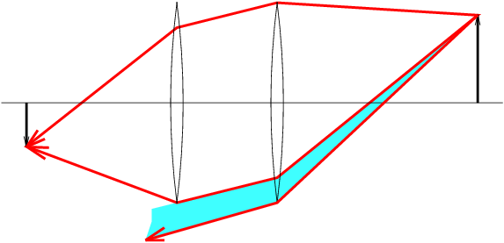
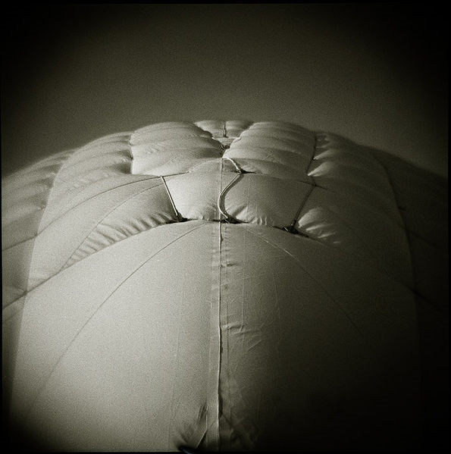
Vignetting
Aberrations can be minimized by well-chosen shapes and refraction indexes, separated by appropriate stops
However, light rays from object points off-axis are partially blocked by lens configuration → vignetting → brightness drop in the image periphery

Slide 33
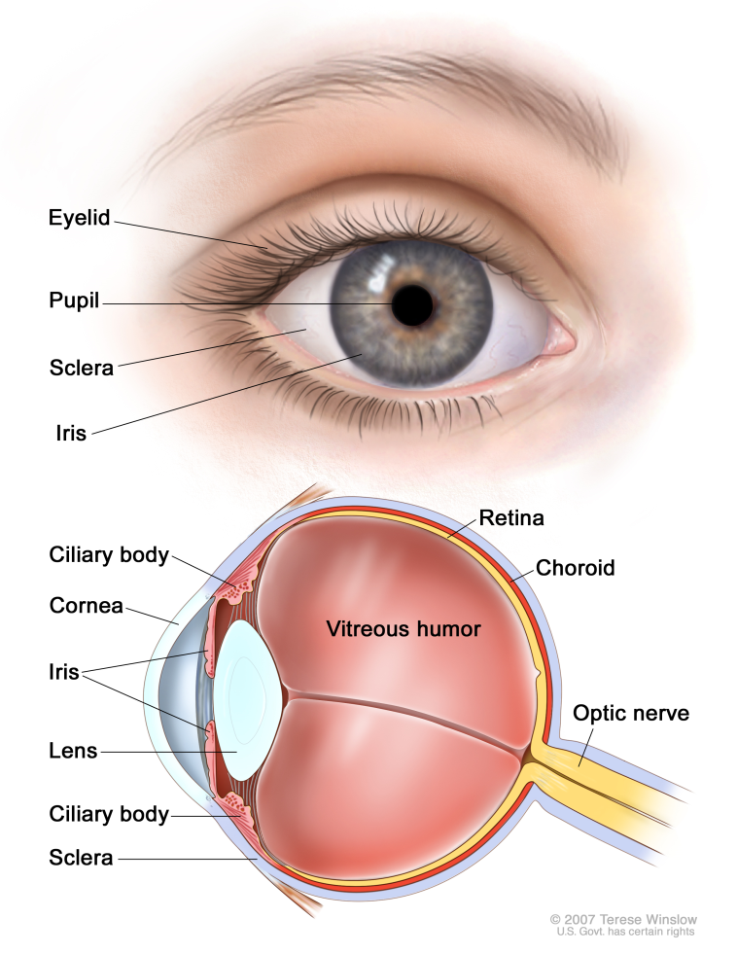

Human eye
Corena: transparent highly curved refractive component
Pupil: opening at center of iris in response to illumination
Helmoltz’s
Schematic
Eye

Slide 34
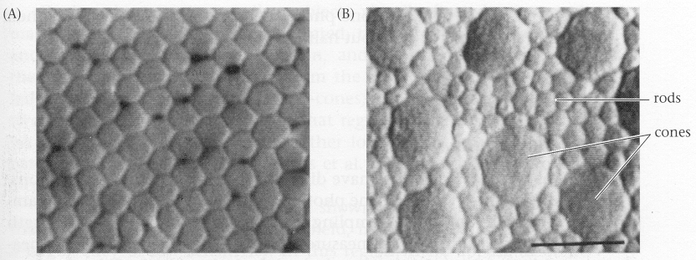
Retina
Retina: thin, layered membrane with two types of photoreceptors
rods: very sensitive to light but poor spatial detail
cones: sensitive to spatial details but active at higher light level
generally called receptive field
Cones in the fovea
Rods and cones in the periphery

Slide 35
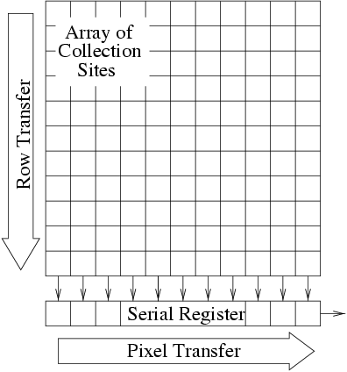
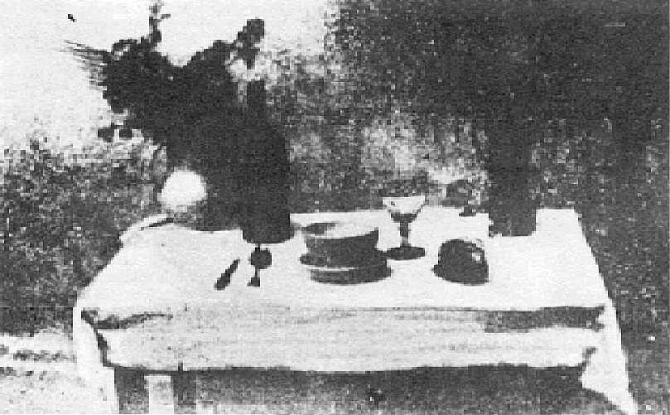
Photographs (Niepce, “La
Table Servie,” 1822)
Milestones:
Daguerreotypes (1839)
Photographic Film (Eastman,
1889)
Cinema (Lumière Brothers,
1895)
Color Photography (Lumière
Brothers, 1908)
Television (Baird, Farnsworth,
Zworykin, 1920s)
Collection Harlingue-Viollet. .
CCD Devices (1970)

Slide 36
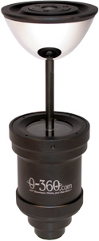
360 degree field of view…
Basic approach
Take a photo of a parabolic mirror with an orthographic lens
Or buy one a lens from a variety of omnicam manufacturers…
See http://www.cis.upenn.edu/~kostas/omni.html

Slide 37
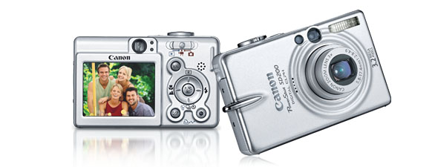
Digital camera
A digital camera replaces film with a sensor array
Each cell in the array is a Charge Coupled Device (CCD)
light-sensitive diode that converts photons to electrons
Complementary Metal Oxide on Silicon (CMOS) sensor
CMOS is becoming more popular
http://electronics.howstuffworks.com/digital-camera.htm

Slide 38
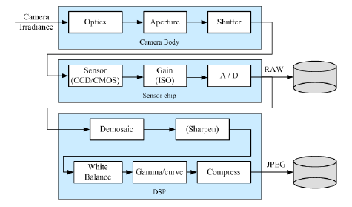
Image sensing pipeline
A simple camera pipeline

Slide 39
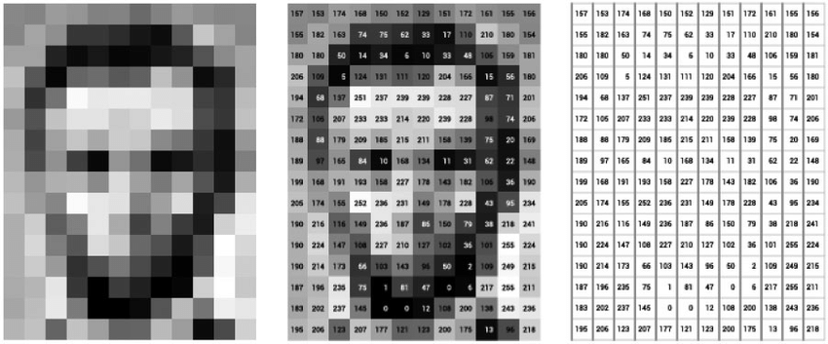
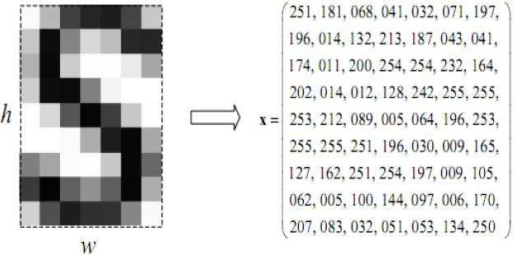
Gray-scale image
Gray scale: 0-255
Usually normalized between 0 and 1 (dividing by 255) and convert it into a vector for processing

Slide 40

In a 19 × 19 face image
Consider a thumbnail 19 × 19 face image
256³⁶¹ possible combination of gray values
256³⁶¹= 2^{8×361} = 2²⁸⁸⁸
Total world population (as of 2021)
7,880,000,000 < 2³³
2⁸⁷ times more than the world population!
Extremely high dimensional space!

Slide 41
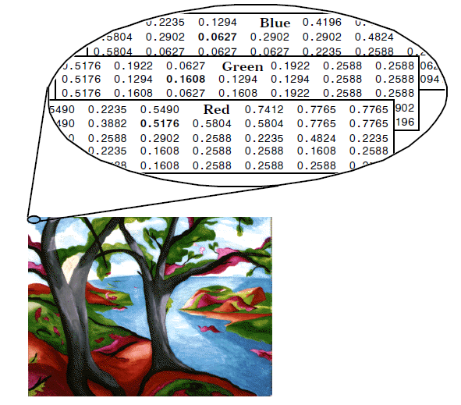
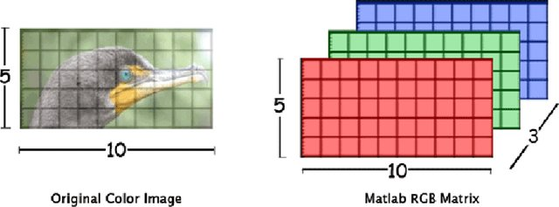
Color image
Usually represented in three channels

